Slide 2
Welcome

Slide 3
What is FIRST?
FIRST is a World wide Robotics competition.
Students are given a game and must design and build a robot to compete in that game.
There are no “kits”, everything is designed and built here in our shop

Slide 4
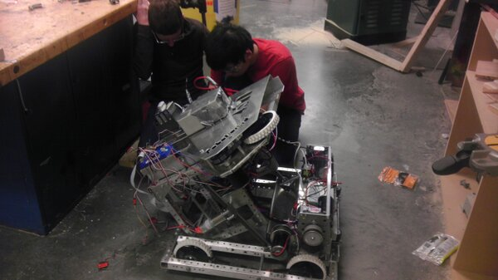
What about the robot?
It looks kind of like this:

Slide 5
Benefits to FIRST
Become part of a team, build relationships.
Learn many new things, new experiences
Builds problem solving skills
Possible scholarship opportunities.

Slide 6
What does a game look like?
An actual game
FIRST Animation

Slide 7
Alright, so that’s cool.
But when does this even happen?

Slide 8
Our Schedule
We will be meeting once a week for the first semester.
When the season starts in second semester, we will meet every day.
Meetings occur before, during, and after school.
“working lunch”
Free periods

Slide 9
What are the expectations?
All members are expected to do the following:
Be committed to the team
Be there
Help with fundraising
Be an advocate for FIRST
Help with outreach
Contribute positively to the team
Find your place
Have a positive attitude
Respect others, and their opinion
Be productive
Use your talents to help the team and the robot.

Slide 10
Financial Expectations
FIRST is VERY expensive
EACH event costs $5000 just to enter
Parts
Each member is expected to contribute to the team financially.
Each team member should expect to raise or pay at least $100 by Nov 1
We will provide a way to raise that money – thru fundraising.
All members should expect to participate in the fundraising efforts.

Slide 11
Skill Sets
Here on the CHS FRC Team, there are various skill areas you can get involved in. These include:
Programming (Java)
3D Design (Autodesk Inventor/CAD)
Mechanics (Assembly)
Electronics
Design (Prototyping)
PR (Public Relations and fundraising)
Website and social media management
Video/Media team
Your unique skills!

